Slide 1
Concept of Projection
Course Code: CSC 3224
Course Title: Computer Graphics
Dept. of Computer Science
Faculty of Science and Technology
Lecturer No: | 9 | Week No: | 07 | Semester:
Lecturer: | Md Masum Billah, billah.masumcu@aiub.edu, masum-billah.net

Slide 2
Lecture Outline
Concept of Model View Projection
Model to World
World to View
View to World
Projection
Types of Projection
Projector

Slide 3
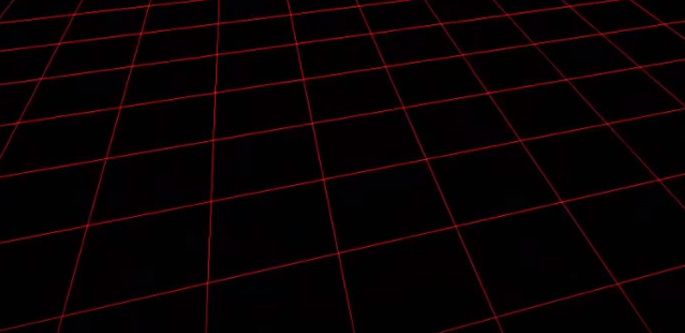
Model to World
Drawing Space

Slide 4
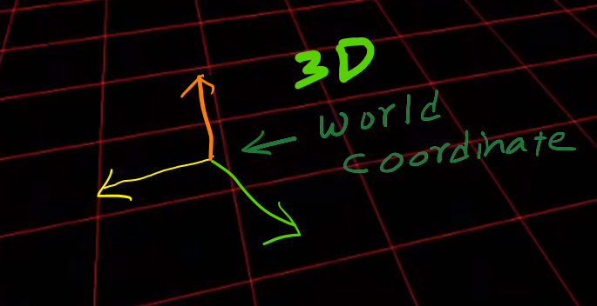
Model to World
3D World Coordinate

Slide 5
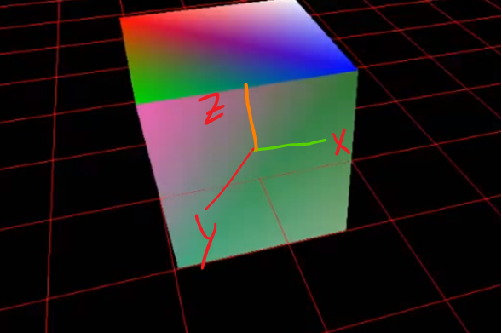
Model to World
Object into World Coordinate

Slide 6
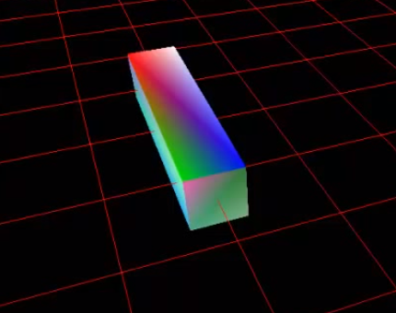
Model to World
Resized the Model

Slide 7
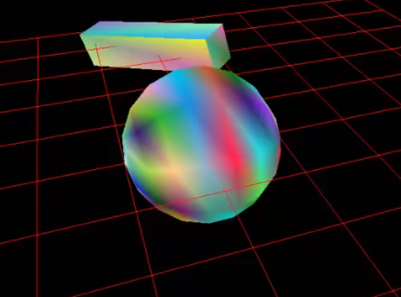
Model to World
Create Another Model (Model to World)

Slide 8
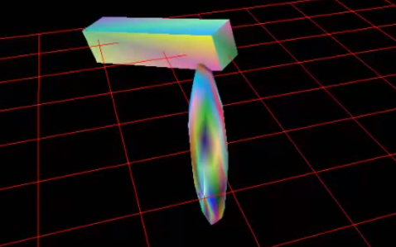
Model to World
Resizing the Sphere

Slide 9
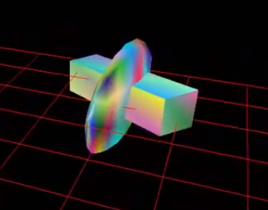
Model to World
Put the two object like following:

Slide 10
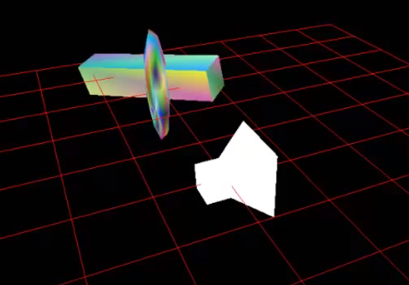
World Matrix to View Matrix
Added Camera in World Matrix

Slide 11
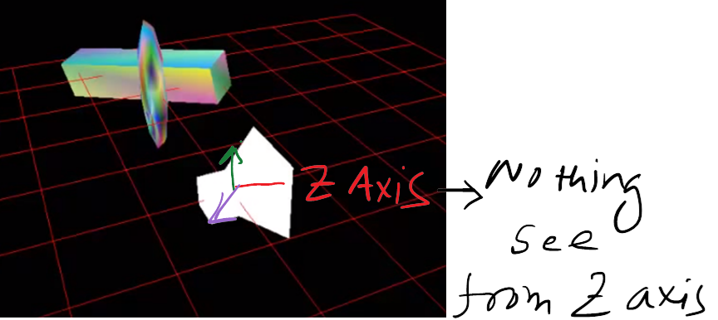
World Matrix to View Matrix
Added Camera in World Matrix

Slide 12

World Matrix to View Matrix
View from Camera (Nothing to See)

Slide 13
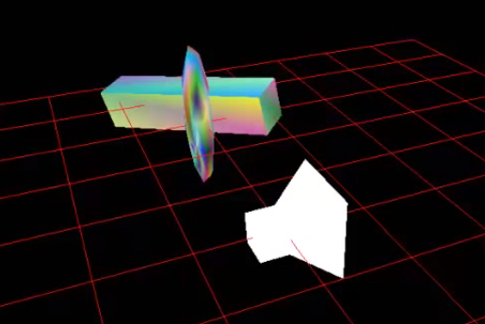
World Matrix to View Matrix
Solution: Move the camera toward the object

Slide 14
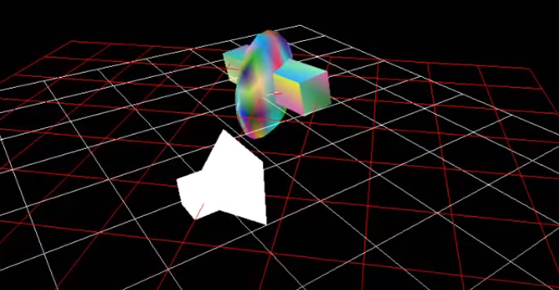
World Matrix to View Matrix
Transforming Object to Camera Position

Slide 15
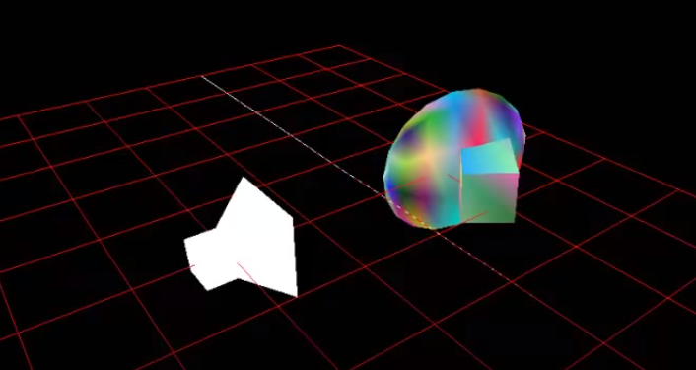
World Matrix to View Matrix
Bought Object on Camera

Slide 16
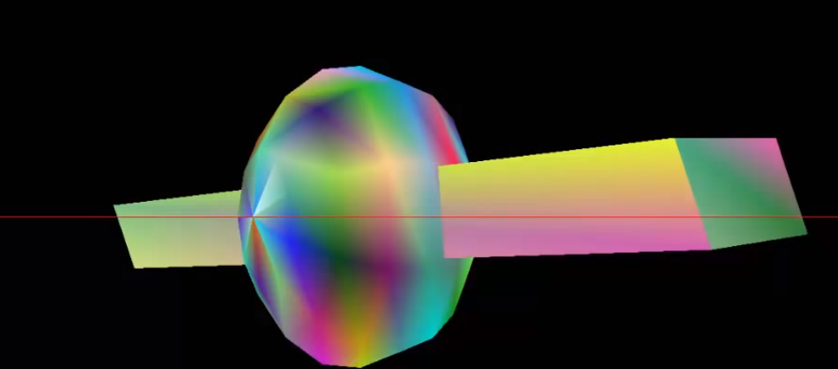
World Matrix to View Matrix
Object View from Camera

Slide 17
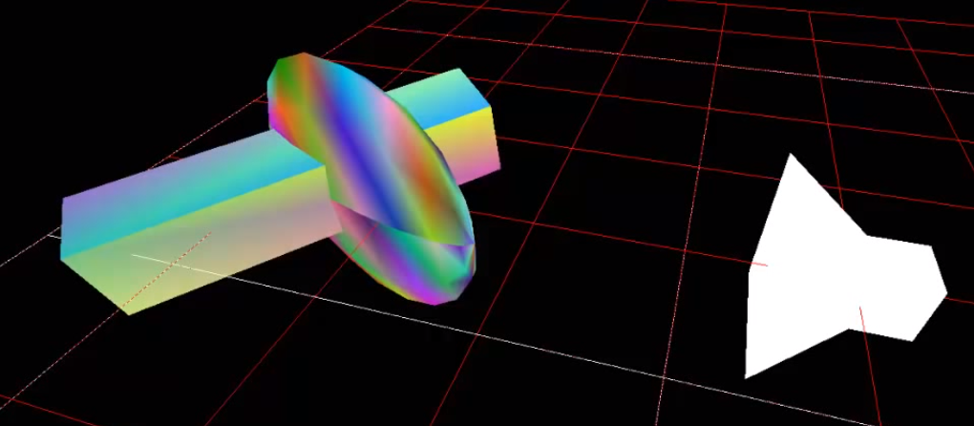
World Matrix to View Matrix
World Still in 3D

Slide 18
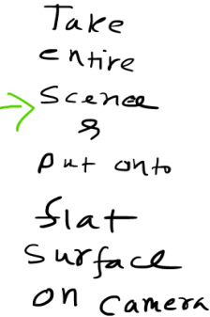
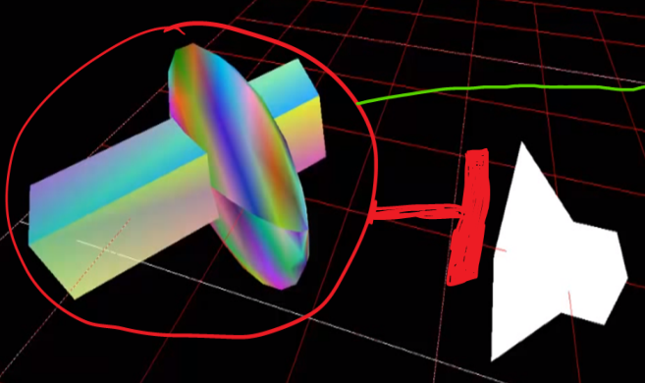
View to Projection
3D World to 2D Space…(Projection Task)

Slide 19
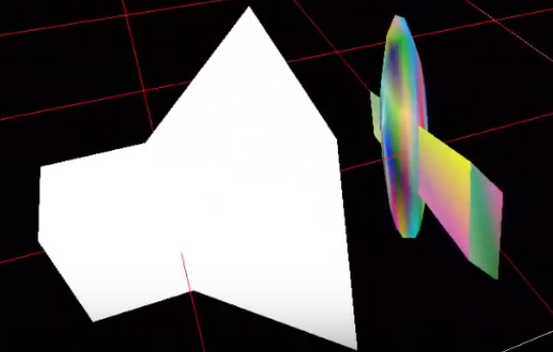
View to Projection
3D World to 2D Space…(Projection Task)

Slide 20
Projection
Definition
Projection in computer graphics means the transformation of a three-dimensional (3D) area into a two-dimensional (2D) area.

Slide 21
Projection Plane
Definition
The projection plane in the area into which we transform (project) objects. i.e project map data onto a flat surface.

Slide 22
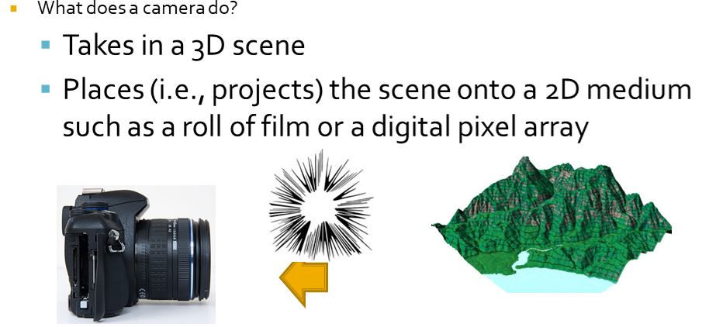
Projection
Example

Slide 23
Projection
Viewing and Viewport
The viewing-coordinate system is used in graphics packages as a reference for specifying the observer viewing position and the position of the projection plane.
the viewport is an area (typically rectangular) expressed in rendering-device-specific coordinates, e.g. pixels for screen coordinates, in which the objects of interest are going to be rendered.

Slide 24
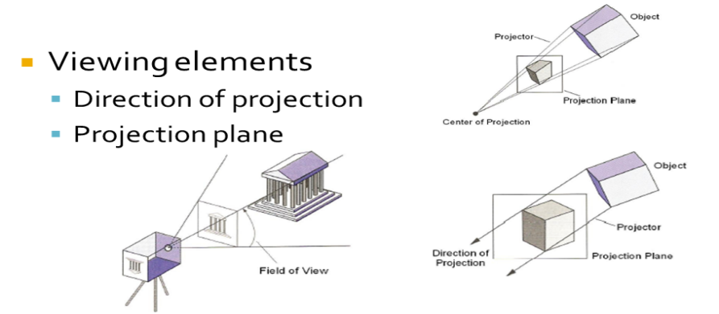
Projection
Perspective and Parallel Projection

Slide 25
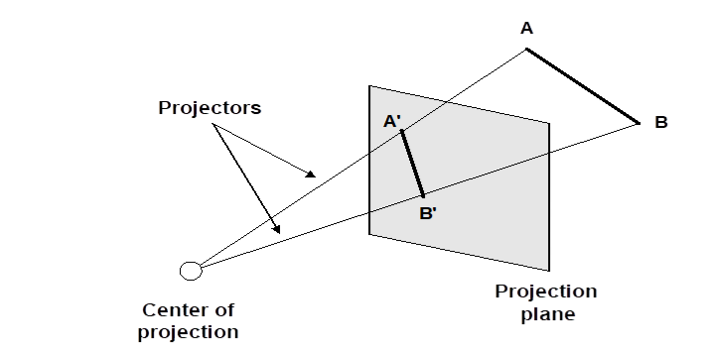
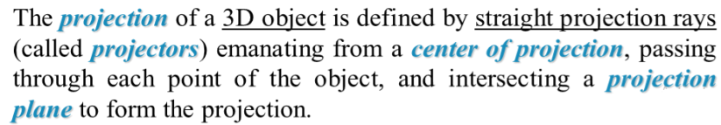
Projector
Definition

Slide 26
Books
Foley, van Dam, Feiner, Hughes, Computer Graphics: principles and practice, Addison Wesley, Second Edition.
Schaum's Outline of Theory & Problems of Computer Graphics.
Peter Shirley Steve Marschner , “Fundamental of computer graphics”, Third Edition.

Slide 27
References
Chapter 6: Basic Raster Graphics Algorithm for Drawing 2D Primitives.
Foley, van Dam, Feiner, Hughes, Computer Graphics: principles and practice, 2nd ed.
https://en.wikipedia.org/wiki/3D_projection
https://www.slideshare.net/SanuPhilip/projection-in-computer-graphics

